Slide 1
Student Grade Prediction
By Mohammad Parahoo
Course: Machine Learning 3253

Slide 2
Objective
Identify and develop a model to predict student grades in math
Dataset:
kaggle.com
Student achievement in secondary education at two Portugese schools.
Data was collected through questionnaires

Slide 3
Data Exploration
395 Students
15 numerical input variables
17 categorical input variables
1 output variable
Input Variables: School, Sex, Age, Address, Family Size, Parent Status, Mother’s Education, Father’s Education, Mother’s Job, Father’s Job, Reason, Guardian, Travel Time, Study Time, Failures, School Support, Family Support, Paid Classes, Extra curricular activities, Nursery, Higher Education, Internet, Romantic, Family relationship, Free Time, Going Out, Alcohol Consumption, Weekend Alcohol Consumption, Health, Absences, First Grade, Second Grade
Output Variable: Third Grade

Slide 4
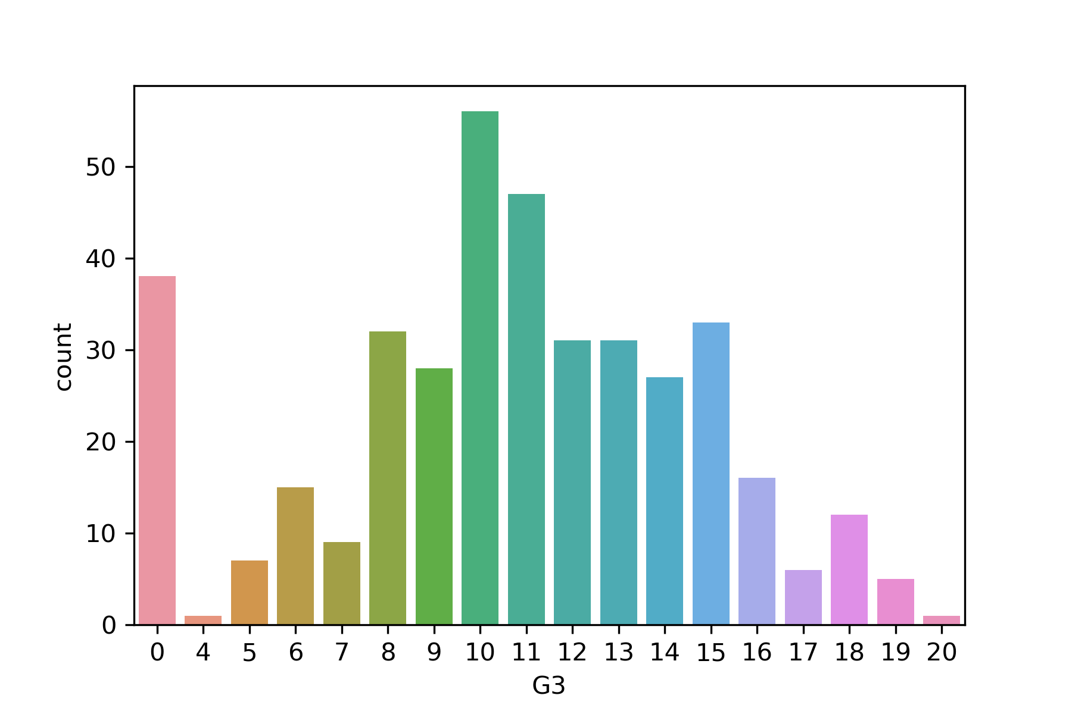
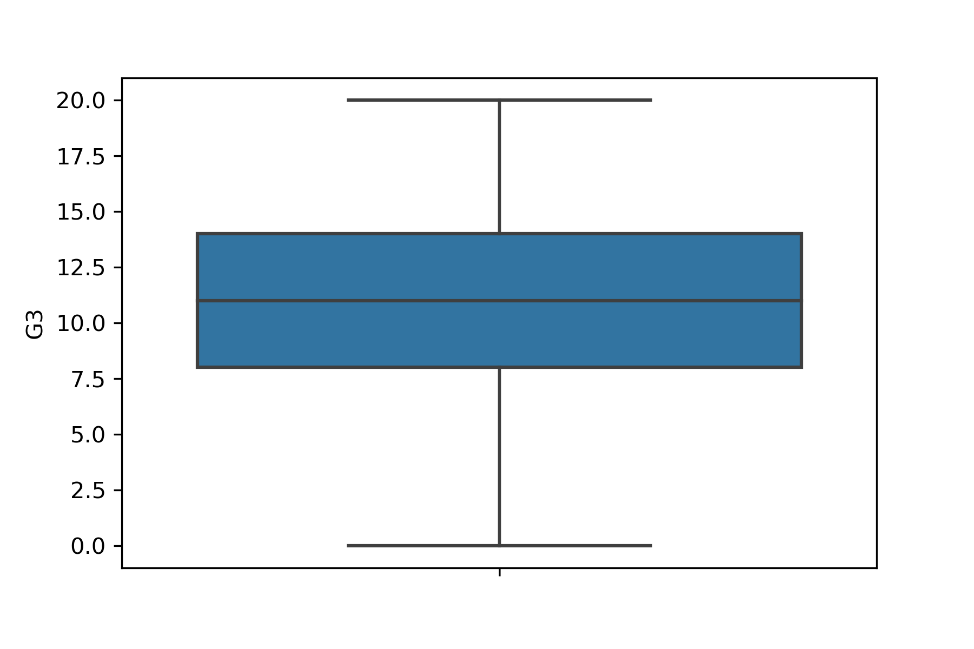
Data Exploration - Target Variable G3
Target variable follows a normal distribution, except for large number of people at 0
Max value 20, Min value = 0, Median = 11

Slide 5
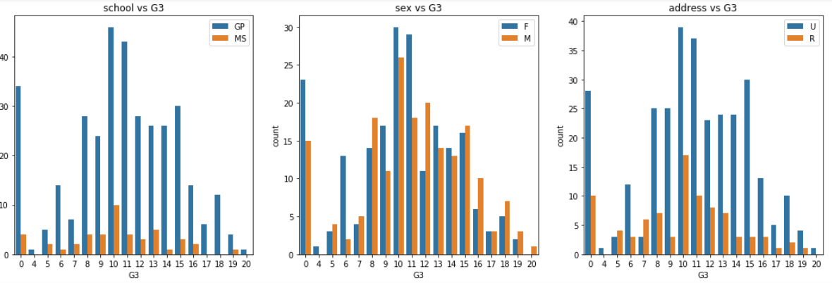
Data Exploration - Input Variables vs Target Variables

Slide 6
Conclusion from Exploratory Analysis
GP school has better scores than MS school
Male students did better than female
Students with high absences have lower scores
Students that intend on pursuing higher education have better scores

Slide 7
Data Preparation
MinMax Standardization for numerical variables
Encoding Yes/No as 1 and 0
One Hot Encoding

Slide 8
Correlation Matrix
G3 | 1.000000
G2 | 0.904868
G1 | 0.801468
failures | 0.360415
Medu | 0.217147
higher | 0.182465
age | 0.161579
Fedu | 0.152457
goout | 0.132791
romantic | 0.129970
G2 and G1 seems to exhibit multicollinearity with the target variable and will be dropped

Slide 9
Machine Learning Algorithms
Linear Regression (Baseline)
Lasso Regression
Ridge Regression
ElasticNet Regression
KNN Regressor
Support Vector Regressor
Random Forest Regressor
GridSearchCV implemented for hyperparameter tuning

Slide 10
Results
Model | Root Mean Square Error
Linear Regression (BaseLine) | 4.056562116192928
Lasso Regression | 4.149234622543421
Ridge Regression | 4.143983721037678
Elastic Net | 4.084531743429293
KNN Regressor | 4.267792243410098
SVM | 5.305836289801752
Random Forrest | 4.081493208716665

Slide 11
Conclusion
Linear Regression (Base Line Model) yielded the best results
Different number of input variables were used
GridSearchCV was used for hyperparameter tuning
High RMSE maybe due to removal of G1 and G2 (highly correlated variables)
Possible Approach to increase accuracy:
Calculate the average score for each student over the three grades
Bin the results as only Pass/Fail or into 4 distinct categories: Fail, Pass, Good, Excellent

